Slide 1


HARPER
Design Thinking Innovation (ECSE235)
Block OverFlow (EB – 09)
Mentor Name: Dr. Manjit Kaur
Submitted By:
Pranjal Bhardwaj (E19CSE432)
Atindra Shekhar (E19CSE187)
Sadhil Chhabra (E19CSE299)

Slide 2

Table of Content
Introduction
Problem Statement
Objectives
Role of each group member
Proposed Methodology
Features of your project
Tools and technology
System/User Requirement
Snapshot of System
Results
Conclusion
Future Scope
References

Slide 3
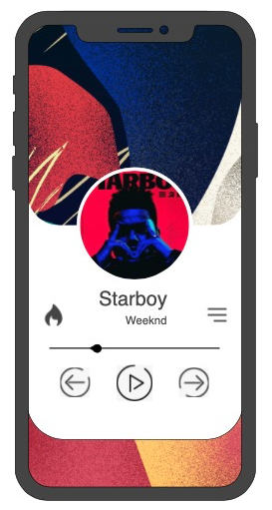
INTRODUCTION
The project is a Music Player that automatically as per the preference of the user would download the music in the local storage for anytime playing.
This would provide the user a variety of music available locally for any time playing without downloading each song individually.
The project is made using two major tools, first being the XCode and the other being the Android Studio.
The download module was supposed to use data retrieved from the YouTube API but since the application could not get registered and verified by Google, we have added data to the code to show how we had expected the application to work.

Slide 4
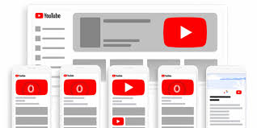

PROBLEM STATEMENT
There are a few music streaming services out there, but none of them provides the features that would. Firstly, YouTube is a great music streaming service but it streams videos along with songs and does not provide background playback . Secondly other streaming services like Spotify, JioSaavn, Gaana and Wynk, do not provide download feature and have a lot of advertisements.

Slide 5
OBJECTIVES
The user should be able to login into the application safely.
If the user is not registered, the user should be able to register new users to the database.
The user should be able to play music file in the application.
The music must continue to play in the background.
Music file must automatically download and store itself to the persistent storage.
The user must be able to see the updated list after the song downloads.

Slide 6
ROLE OF EACH GROUP MEMBER
Member Names | Major contributions
Pranjal Bhardwaj | Swift iOS App Development Project Summary Project Report Documentation Project PowerPoint Presentation Poster Work Video Editing
Atindra Shekhar | Android Application Development Project Summary Project Report Documentation Project PowerPoint Presentation Poster Work Video Editing
Sadhil Chhabra

Slide 7
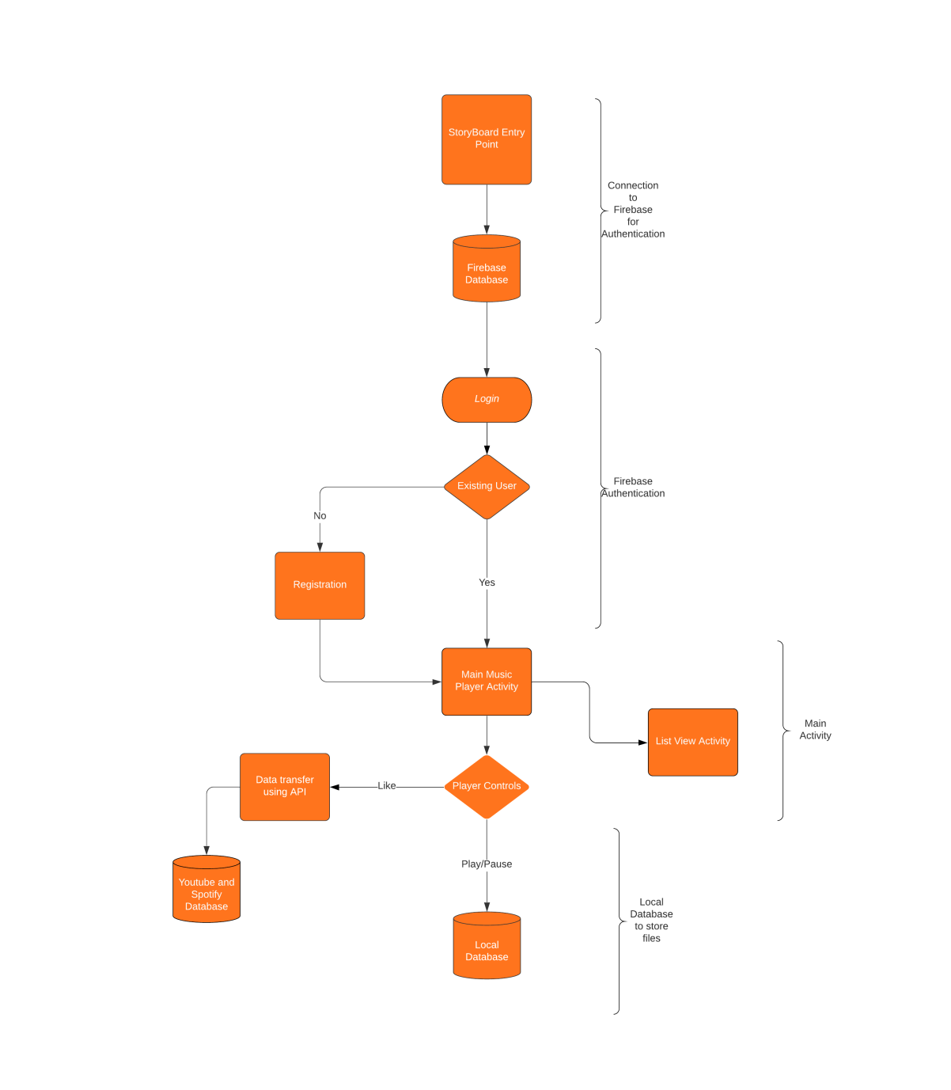
PROPOSED METHODOLOGY
Fig. Control flow of the different modules.

Slide 8
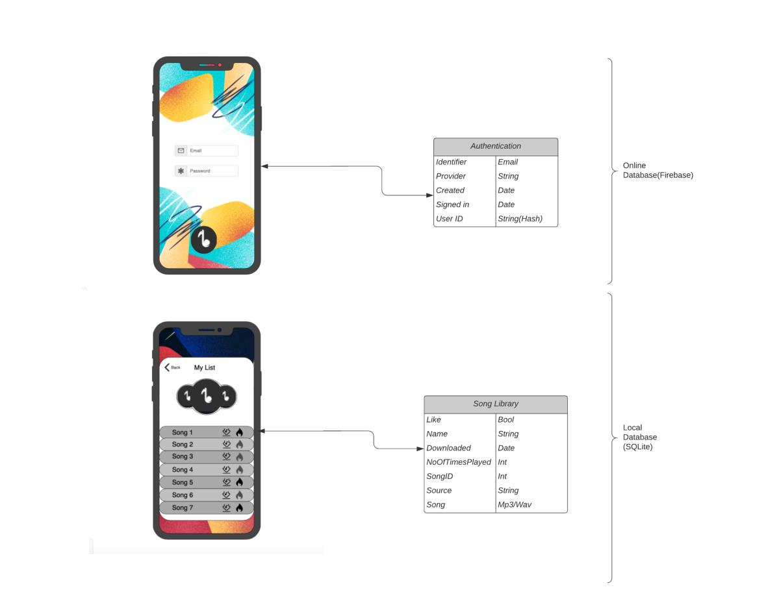
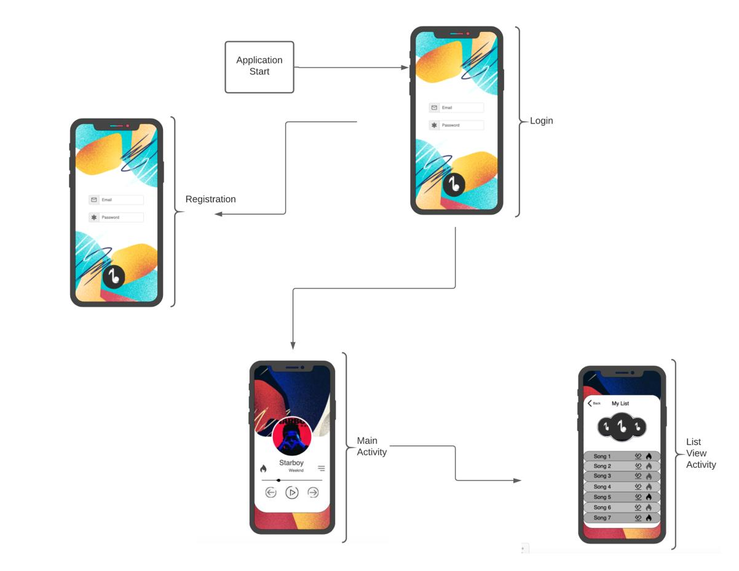
PROPOSED METHODOLOGY
JAVA Application(Computer)

Slide 9
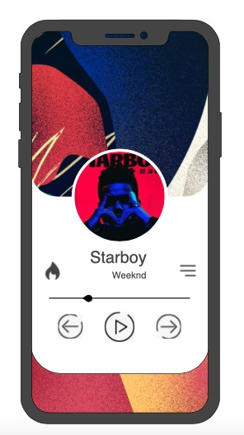
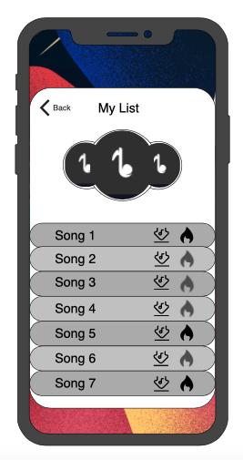
FEATURES OF OUR PROJECT
User Login and Registration Page
Secure cloud Authentication
Background Music Playback
Attractive UI and UX Design
Persistent Data Storage
List View to Display the Song List
Automated Download of the songs

Slide 10
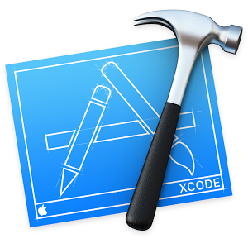

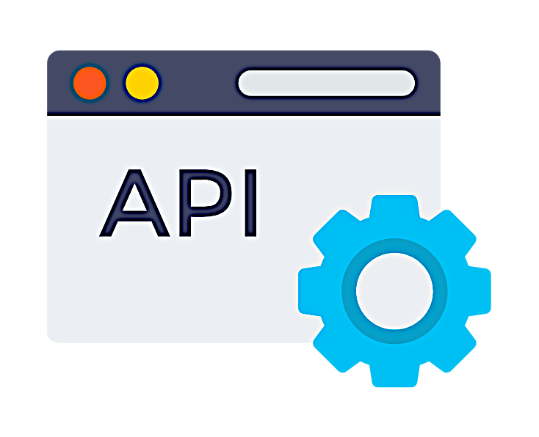



TOOLS AND TECHNOLOGY

Slide 11

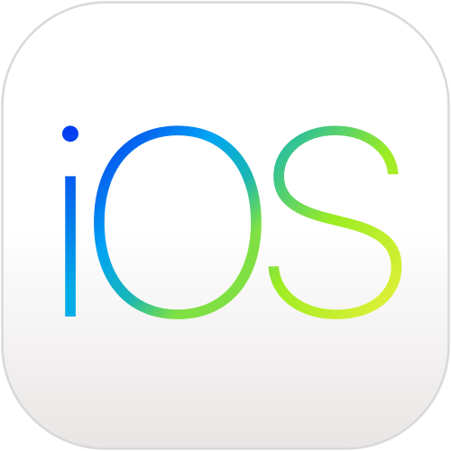
SYSTEM / USER REQUIREMENTS

Slide 12
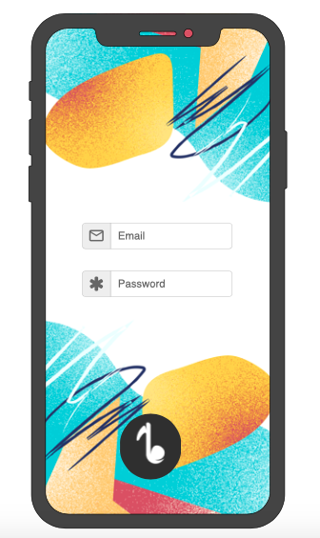
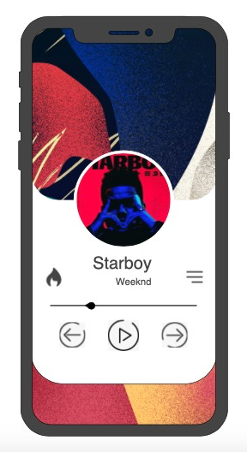
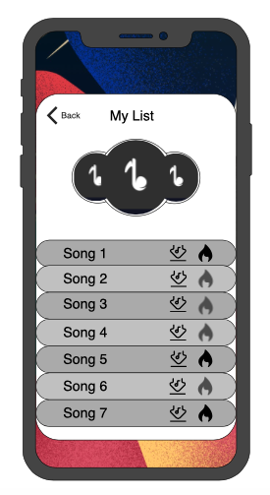
SNAPSHOT OF THE SYSTEM

Slide 13
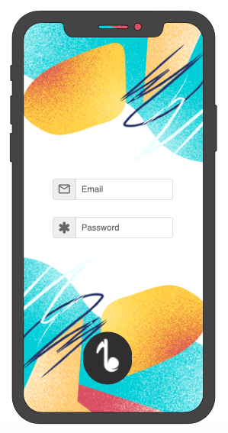
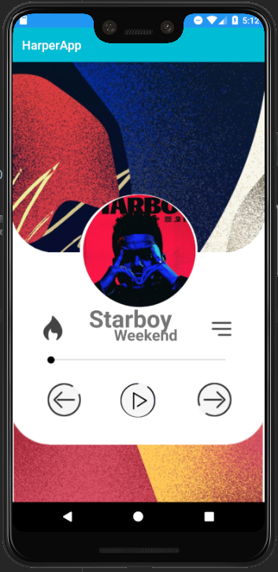
RESULTS
Swift and JAVA Application (Mobile and Desktop)
Login and Registration Page
Secure Authentication
3. Song Player
4. Easy controls and effective UI of the application
5. List View of all the local songs
6. Automatic download of songs to the user’s device
7. Dynamic segue of the modules

Slide 14
CONCLUSION
We have tried our best to develop the application as much as possible but there have been some barriers that cannot be crossed now.
Like the possibility of Google verifying our application to access user’s data.
Therefore, we have tried to depict the best possible way this application should work with some test data. The user can use the application as a music player.
The user can see the song being downloaded to the device and can be accessed in the offline mode. We have made an application that depicts how the application would work.

Slide 15
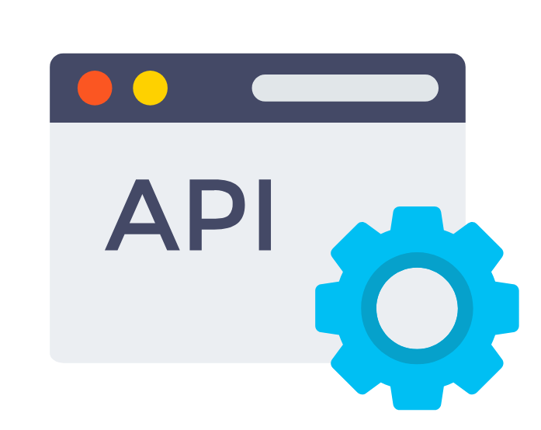


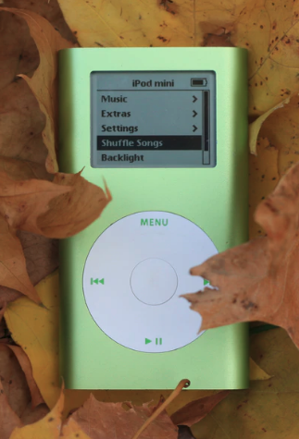
FUTURE SCOPE
We are looking forward to retrieve user’s data from major APIs that would help us in generating the mp3 file from a custom server. This application could come to a great success if we could use a specific server that could return the converted files to the devices after requests. Therefore, we would like to do these two things first.

Slide 16
REFERENCE
UI/UX Design References
https://www.vectorstock.com/royalty-free-vector/liquid-background-best-music-player-ui-ux-gui-vector-25958868
https://dribbble.com/shots/9977109-CCA-App-Splash-Screen-Video-Player
https://dribbble.com/shots/6719410-Music-Player-App-Concept
https://app.moqups.com/o6BDLvhuem/edit/page/a88be41aa
Icons
https://www.vectorstock.com/royalty-free-vector/liquid-background-best-music-player-ui-ux-gui-vector-25958868
https://www.flaticon.com
Apple Developers Reference
https://developer.apple.com/av-foundation/
https://developer.apple.com/library/archive/samplecode/AVFoundationSimplePlayer-iOS/Introduction/Intro.html
https://developer.apple.com/documentation/avfoundation
4. GitHub Code Reference
https://github.com/bpolat/Music-Player/blob/master/Music%20Player/PlayerViewController.swift
5. API References
https://mobikul.com/play-audio-file-save-document-directory-ios-swift/
https://github.com/devMadrit/MKYoutubeMp3Downloader

Slide 17
THANK – YOU

